Slide 1
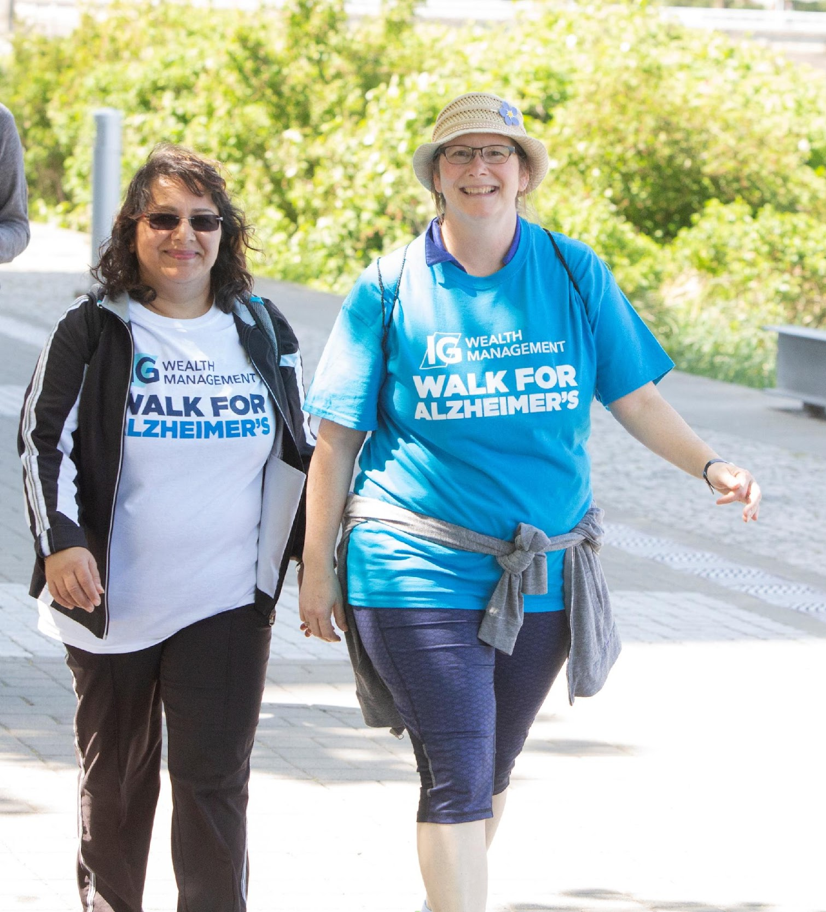

2022
Regional
Sponsorship Package

Slide 2
Alzheimer Society of B.C.
Approximately 70,000 people in B.C. are affected by Alzheimer’s disease or other dementias and this number is expected to
double by 2034.
The Alzheimer Society of B.C. is the only provincial charity dedicated to supporting people affected by dementia to live their best lives.
Our vision is a world without dementia, and that world begins with a more dementia-friendly society, where people affected by dementia are acknowledged, supported and included.
To achieve this, the Alzheimer Society of B.C. not only offers support programs and provides education, but we also advocate for change and support research into the disease to ensure that people affected by dementia are not alone.

Slide 3





Did you know…
One in five Canadians have experience caring for someone living with dementia.
Family members and caregivers spend an average of 26 hours per week supporting a person with dementia.
  Canadians spend $10.4 billion a year to care for people living with dementia.
  70 per cent of the Alzheimer Society of B.C.’s funding comes from generous community support.
This support allows us to serve families, caregivers, and those affected by dementia in over 91 communities across B.C.

Slide 4
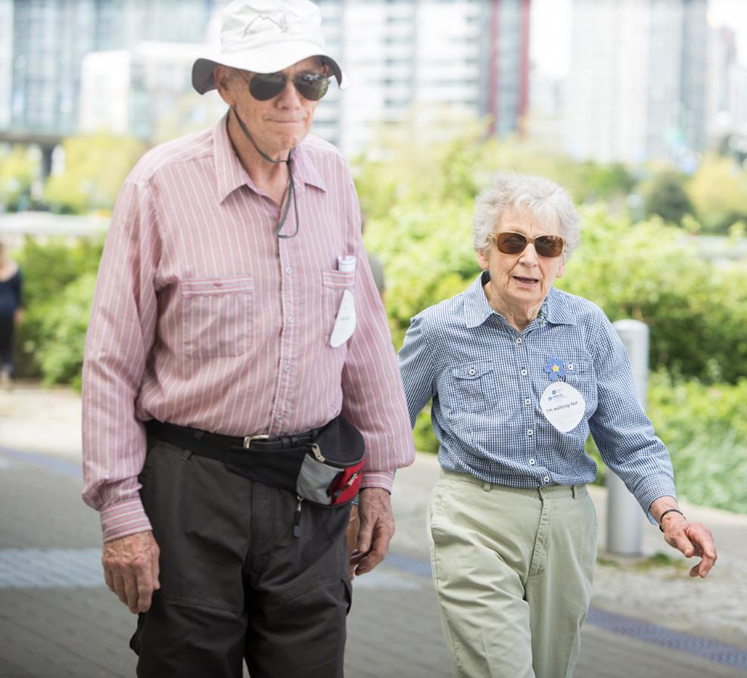
What is the IG Wealth Management Walk for Alzheimer’s?
The IG Wealth Management Walk for Alzheimer’s is the Alzheimer Society of B.C.’s flagship fundraising event in support of people affected by dementia.
For the past two years, we adapted to the rapid changes in our communities and moved the event online. The national event this past May saw approximately ten thousand Canadians show their support for people affected by dementia, and raised over $800,000 in B.C.
This year, we are excited to announce, that we will be returning to in-person walks in 21 locations across B.C.! Join us on Sunday, May 29, 2022, as we walk together in taking a step towards our vision of a world free from Alzheimer’s disease and other dementias and celebrate the differences that we have made in our very own communities.
For more information, please visit: www.walkforalzheimers.ca
Notes:
Do not read off the slide – refer to speaking notes

Slide 5
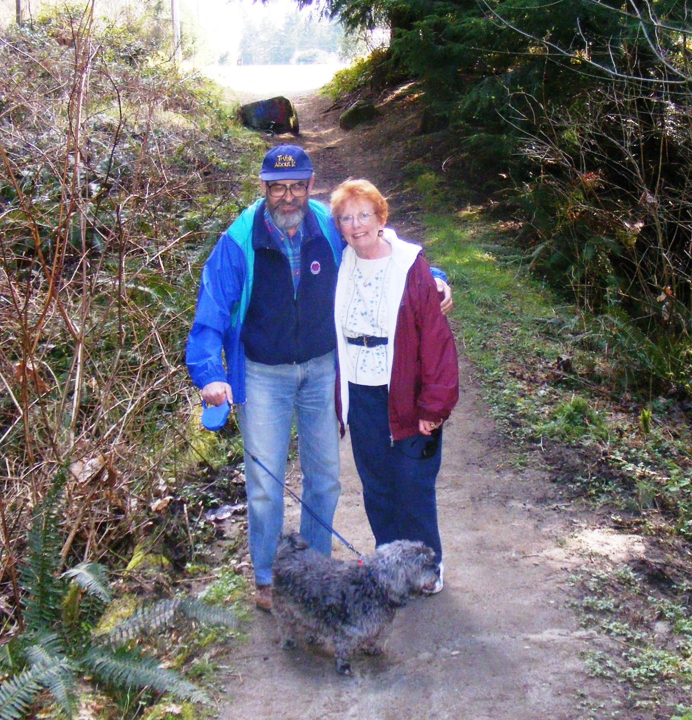
Why we walk
When we walk, we honour the people who have passed and acknowledge the work that must be done to ensure help and support is available for people living with dementia today.
Each Walk is dedicated to a local honouree – an individual or group who has been affected by dementia or who has valuably contributed to the lives of the people living with the disease. Honourees are held in high regard in their community.
Their story is a reminder of why we walk and lets others on the journey know they are not alone.
Notes:
Do not read off the slide – refer to speaking notes

Slide 6
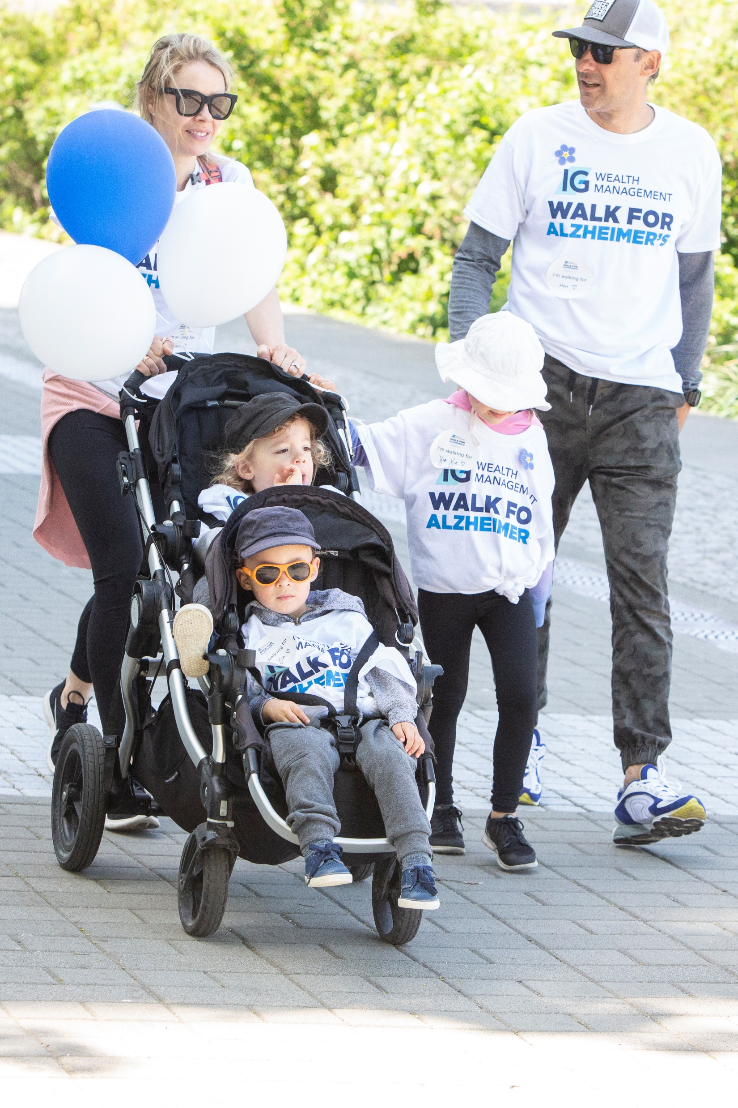
Ways to get involved
Sponsorship
As we transition back to in-person events, we’re pleased to offer three levels of sponsorship this year, ranging from $500 -$2,000. An event sponsorship provides you the opportunity to build brand awareness for your business and to be recognized as an organization that gives back and supports your local community.
Donation
Not looking for any recognition and simply want to support the cause financially? Great! A corporate donation can be made at any time, for any amount. This can be done through cash, cheque or online donation.
Participation
Should a financial contribution not be available at this time, there are still plenty of ways to support the event. Register online as an individual, or, for even more fun, form a team! Get your colleagues/employees registered and then either walk your own way throughout the month of May or join us on May 29^{t}. Set some fundraising goals and create friendly competitions such as the most distance walked. The possibilities are endless! To register, please visit walkforalzheimers.ca
For more information regarding any of these options or for help with brainstorming ideas, please reach out to Rebecca Frederick, Volunteer Sponsorship Coordinator at burnabynewwestwalk@gmail.com.

Slide 7
Regional sponsorship packages
Sponsorship rights & benefits | Regional sponsor $2,000 | Community sponsor $1,000 | Event-day sponsor $500
Logo placement on regional event webpage | x
Opportunity to provide promotional item to event participants* | x
Right to refer to your organization as a ‘proud supporter’ until September 1, 2022 | x
Opportunity to create a sponsor support video to be shared via local Walk Facebook page* | x
On-site activation space (table set up) | x | x
Social media mentions on local Walk Facebook page | x | x
Acknowledgment as event Sponsor in Society Annual Donor Listing | x | x
Opportunity to provide a raffle or silent auction prize | x | x | x
Recognition on event day sponsor signage* | Logo | Logo | Name
Event-day emcee mention during opening ceremony | x | x | x
*Subject to approval and deadlines
Looking for a broader reach outside your local community? Provincial sponsorships are available! For more information, please reach out to Janet Hutzul at 604-742-4938 or jhutzul@alzheimerbc.org

Slide 8
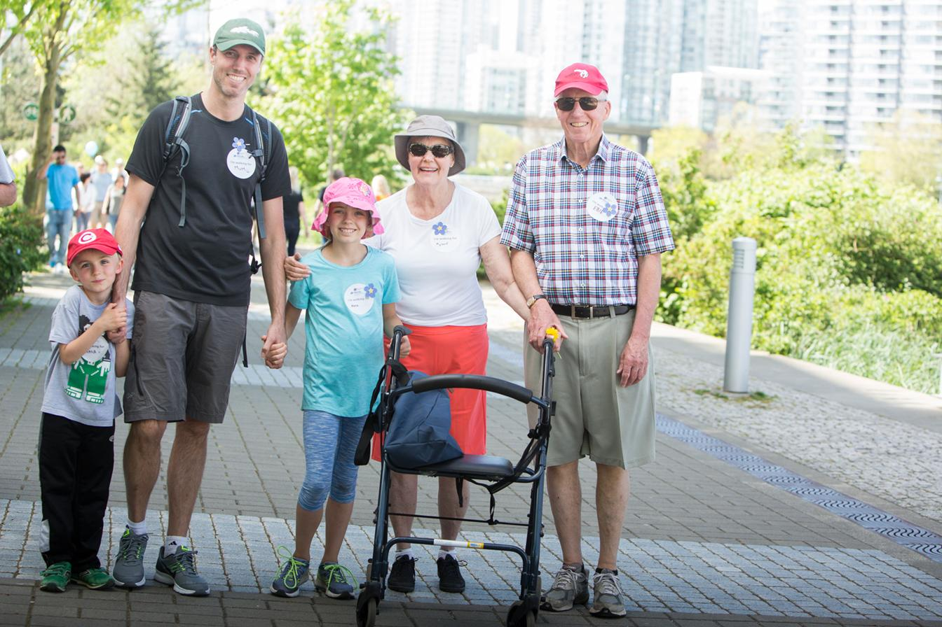
Thank you!
Our work simply cannot be done without the support of like-minded individuals and organizations like yourself.
When you support the Walk for Alzheimer’s, you are supporting those who are affected by dementia right here in your community.
With your help, we can look towards a world without Alzheimer’s disease and other dementias.

